Slide 1
Reduced order modelling of fission gas diffusion in columnar grains using SCIANTIX coupled with TRANSURANUS
M. Di Gennaro, D. Pizzocri, F. A. B. Silva, G. Zullo, L. Luzzi
Politecnico di Milano, Department of Energy, Nuclear Engineering Division, Via La Masa 34/A, I-20156 Milano, Italy
martina.digennaro@polimi.it Progress meeting, 11 June 2024
Notes:
sto avviando una modellazione di questo problema.
TU vede i grani colonnari.
l'idea è questa. propongo un'idea senza ancora risultati.
slide concettuale con i vari step come si fa la riduzione d'ordine.
come far parlare sciantix con transuranus dinamica diversa.

Slide 2
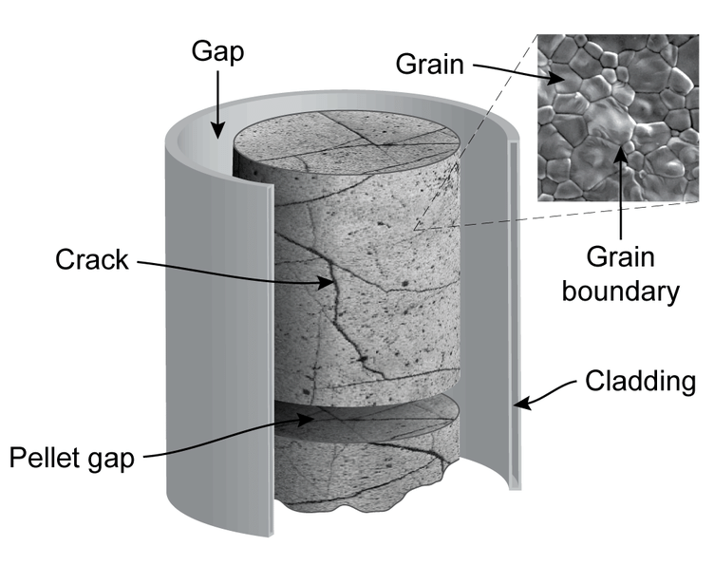
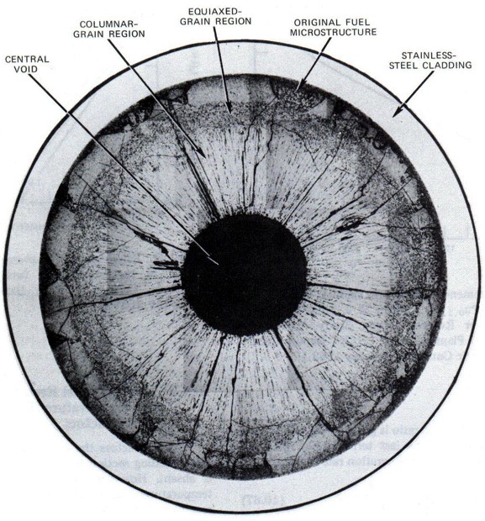
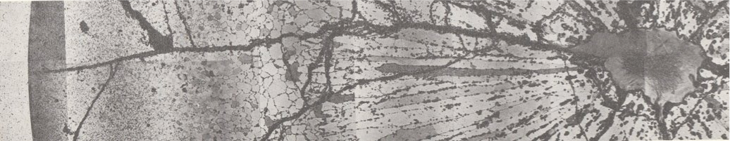
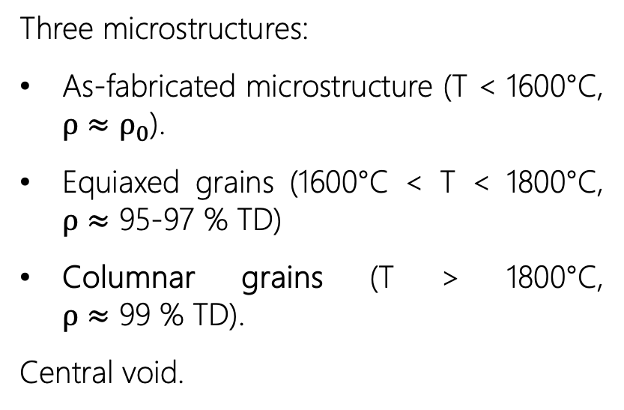

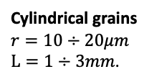
Oxide fuel restructuring in Fast Reactor conditions
Three microstructures:
As-fabricated microstructure (T < 1600°C, $ρ≈ρ_{0}$).
Equiaxed grains (1600°C < T < 1800°C, $ρ≈$ 95-97 % TD)
Columnar grains (T > 1800°C, $ρ≈$ 99 % TD).
Central void.
COOLEST ZONE
HOTTEST ZONE
Spherical grains $r=10μm$.
Cylindrical grains $r=10÷20μm$ $L=1÷3mm$.
BEGINNING OF LIFE

Slide 3
Thank you for your kind attention

Slide 4
Literature
Forsberg, K., Massih, A.R., 1985. Fission gas release under time-varying conditions. Journal of Nuclear Materials 127, 141–145. doi:10.1016/0022-3115(85)90348-4.
Olander, D.R., 1976. Fundamental Aspects of Nuclear Reactor Fuel Elements, Technical Information Center – Energy Research and Development Administration, University of California, Berkeley, CA, USA.
Pastore, G., Swiler, L.P., ... Williamson, R.L., 2015. Uncertainty and sensitivity analysis of fission gas behavior in engineering-scale fuel modeling. Journal of Nuclear Materials 456, 398–408. doi:10.1016/j.jnucmat.2014.09.077.
Pastore, G., Pizzocri, D., Luzzi, L., 2018. An effective numerical algorithm for intra-granular fission gas release during non-equilibrium trapping and resolution. Journal of Nuclear Materials 509, 687–699. doi:10.1016/j.jnucmat.2018.07.030.
Pizzocri, D., Rabiti, C., Luzzi, L., Barani, T., Van Uffelen, P., & Pastore, G. 2016. PolyPole-1: An accurate numerical algorithm for intra-granular fission gas release. Journal of Nuclear Materials, 478, 333–342. https://doi.org/10.1016/j.jnucmat.2016.06.028.
Pizzocri, D., Di Gennaro, M., Barani, T., Silva, F. A. B., Zullo, G., Lorenzi, S., & Cammi, A. 2023. A reduced order model for fission gas diffusion in columnar grains. Nuclear Engineering and Technology, 55(11), 3983–3995. https://doi.org/10.1016/j.net.2023.07.013
Sirovich, L., 1987. Turbulence and the dynamics of coherent structures. I. Coherent structures. Quarterly of Applied Mathematics 45, 561–571. doi:10.1090/qam/910462.

Slide 5
Backup slides

Slide 6
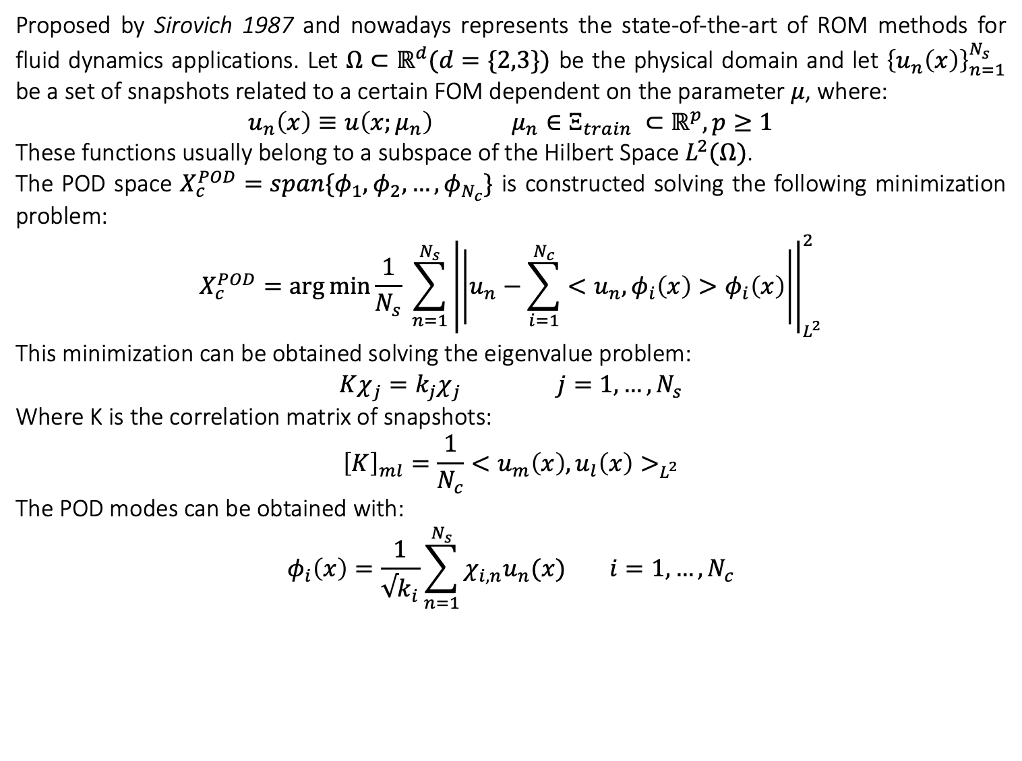
Proper Orthogonal Decomposition procedure
Proposed by Sirovich 1987 and nowadays represents the state-of-the-art of ROM methods for fluid dynamics applications. Let $Ω⊂ℝ^{d}(d=\{2,3\})$ be the physical domain and let ${\left\{u_{n}\left(x\right)\right\}}_{n=1}^{N_{s}}$ be a set of snapshots related to a certain FOM dependent on the parameter $μ$, where:
$$u_{n}\left(x\right)≡u\left(x;μ_{n}\right) μ_{n}∈Ξ_{train} ⊂ℝ^{p}, p≥1$$
These functions usually belong to a subspace of the Hilbert Space $L^{2}(Ω)$.
The POD space $X_{c}^{POD}=span\{φ_{1},φ_{2}, …,φ_{N_{c}}\}$ is constructed solving the following minimization problem:
$$X_{c}^{POD}=\arg{\min{\frac{1}{N_{s}} \sum_{n=1}^{N_{s}}{{\left|\left|u_{n}−\sum_{i=1}^{N_{c}}{<u_{n}, φ_{i}\left(x\right)>φ_{i}\left(x\right)}\right|\right|}_{L^{2}}^{2}}}}$$
This minimization can be obtained solving the eigenvalue problem:
$Kχ_{j}=k_{j}χ_{j} j=1,…, N_{s}$
Where K is the correlation matrix of snapshots:
$${\left[K\right]}_{ml}=\frac{1}{N_{c}}<u_{m}\left(x\right), u_{l}\left(x\right)>_{L^{2}}$$
The POD modes can be obtained with:
$$φ_{i}\left(x\right)=\frac{1}{√k_{i}}\sum_{n=1}^{N_{s}}{χ_{i,n}u_{n}(x)} i=1,…, N_{c}$$

